Slide 1

Customer Insight and Market Analysis
Session 03
Course : Software Engineering
Effective Period : Desember 2017

Slide 2
These slides have been adapted from
Schaper, Michael et al. 2011. Entrepreneurship and Small Business 3-rd Asia-Pacific Edition. John Wiley & Sons Australia, Ltd. Milton. ISBN: 978-1-74216-462-5. Chapter 6.
Acknowledgement

Slide 3

LO 1 : Describe the concepts of software process models and the opportunity for potential business project
Learning Objectives
muovorecruitment.blogspot.com

Slide 4

Contents
The role of Market Research
Conducting Research
Developing a Strategy
Developing a Business Model
marketing.anchormobile.net

Slide 5

The Role of Market Research
Common problems faced by entrepreneurs is a lack of information that relates to their business idea
A lack of research is a key inhibitor to new venture creation
A lack of effective research can also create less obvious barriers to business survival and growth

Slide 6

What is Market Research?
Refers to the use of information to identify and define market opportunities and problems
Used to generate, refine and evaluate marketing-related activities within a small firm or to help determine future marketing strategies and sales forecasts for a new business venture
www.rhinomarketresearch.com

Slide 7

What to Research?
What information should be investigated?
Marketing describes the environment of the entrepreneur in terms of an ‘onion’, which consist of three different degrees of interaction:
  the market
  the industry
  the macro-environment

Slide 8

What to Research?
the Market
Consists of the people or firms who could benefit from the new product, have the means to buy it and will be offered the opportunity to do so
Information requirements about the market include:
  the customer profile(s) and segment(s)
  the product or service
  the price
  sales and distribution channels

Slide 9
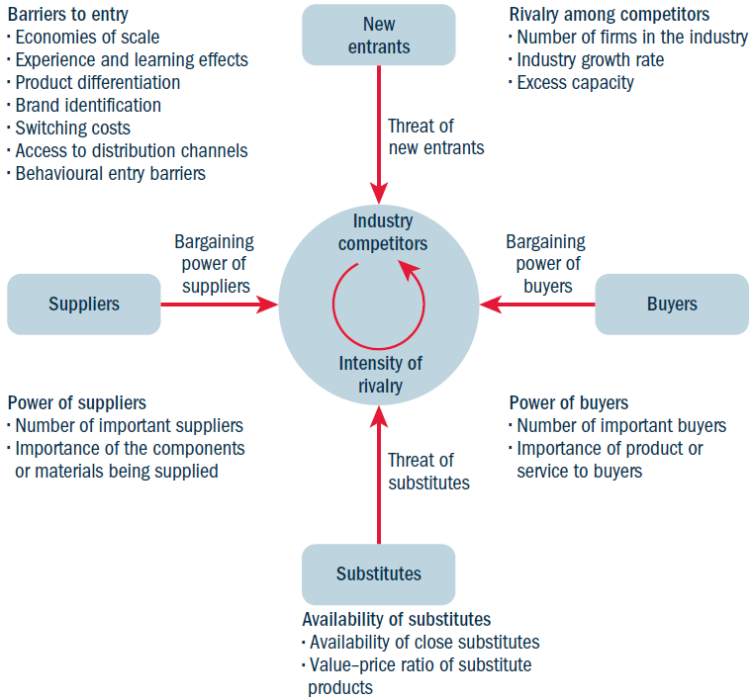
What to Research?
The industry
Figure 6.1 Porter’s five forces. (c) 1985, 1998 by Michael E Porter. In Schaper, 2011.

Slide 10
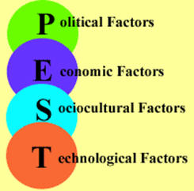
What to Research?
The Macro Environment
The macro-environment is often not recognised as a force on organisations
These external factors are most often grouped as the PEST analysis
  Political
  Economic
  Social
  Technological

Slide 11
Recognizing Opportunity
(Check List)
Does my business concept come from one or more of the following opportunities ? (Give a check)
Solving a problem
Identifying a need
Studying the market
Learning industry characteristic
Responding to competition
Researching demographic trends
Being sensitive to lifestyle changes
Supporting emerging consumer habits
Watching emerging trends
If not, how do I describe the source of my business concept and how do I know it is a sound business opportunity?

Slide 12
Personal Network
(Check list)
Who in your personal network would be helpful in identifying potential opportunities?
List their names below …

Slide 13
Industry Profile
(Check list)
What do you already know about your industry, and what do you still need to know?
Check the following items to determine what you still need to research about your industry.
Industry Characteristic | Already Know | Need to research
Current Size
Growth Potential
Profitability
Trends
Distribution Channels

Slide 14
Who is My Customer
(Check list)
Who is the primary user of my product/ service?
Are the user, the decision maker, and the buyer the same person for my product/ service?
Yes
No
Who influences the buying decision?
Is my business primarily
B2B or
B2C

Slide 15
Competitive Profile
(Check list)
Here are three direct competitors for my product/ service:
……
……
…...
Here are three indirect competitors for my product/ service:
……
……
…...
What other products/services could be substituted for my product/service?
How could I find out what customers are substituting for my product/ service?

Slide 16
Setting Prices
(Check list)
What pricing positions do my closest competitor use?
Lower?
Higher?
Parity?
How does their pricing position align with their competitive advantage?
What pricing position is consistent with the image I want to have in the market?
Lower?
Higher?
Parity?
What pricing constraint have I found in my industry?
How will these issues affect my pricing position?

Slide 17
References
Schaper, Michael.(2011). Entrepreneurship and Small Business 3-rd Asia-Pasific Edition. John Wiley & Sons Autralia, Ltd. Milton. ISBN: 978-1-74216-462-5.
http://www.uj.ac.za/EN/Research/Statkon/Documents/Statkon%20Example%20Questionaire.pdf

Slide 18
Q & A

